Slide 1

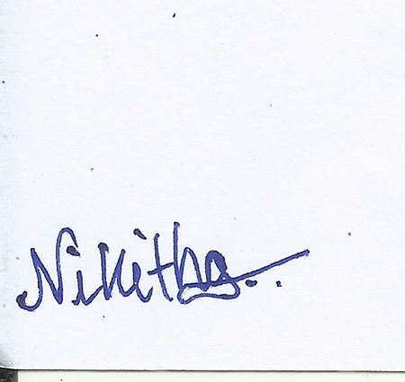
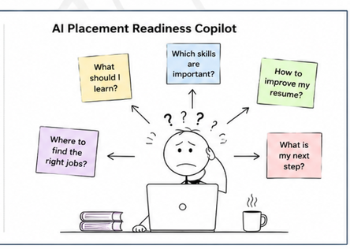
Team Name (Registered on Devfolio): Warriors Theme: Open Innovation
University/Institute name: AMC Engineering College city/state: Bengaluru, Karnataka
Problem Statement Title: NextStep AI – AI Placement Readiness Copilot
Problem
Students and freshers struggle to prepare effectively for internships and placements
due to fragmented resources and lack of personalized guidance.
Key Challenges
No clear career roadmapare scattered
Lack of personalized guidance
Our Solution
NextStep AI helps students through:
AI Resume Analyzer
AI Job Match & Skill Gap
Generic resumes reduce opportunities
Skills don't match job requirements
Preparation resources Detection
Personalized Learning Roadmap
Daily Career Action Planner
One platform for complete placement preparation

Slide 2
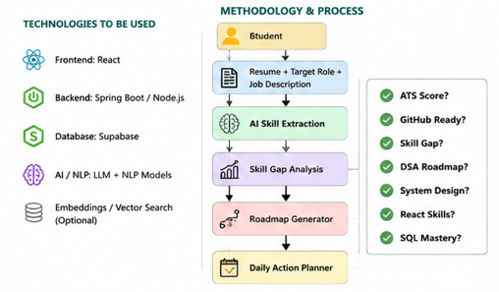
TECHNICAL APPROACH
Frontend
React.js
Backend
Spring Boot / Node.js
Database
Supabase
AI/NLP
Large Language Models (LLMs)
Natural Language Processing (NLP)
Additional
Vector Search (Optional)
REST APIs
GitHub
@DevHack Idea submission- Template
3

Slide 3

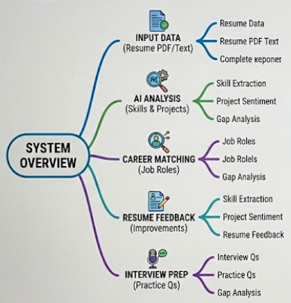
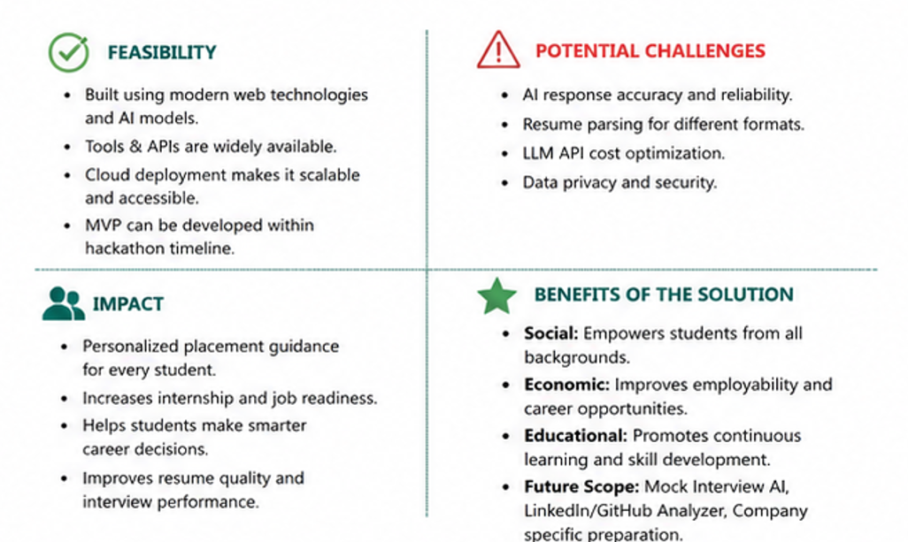
Team Warriors
FEASIBILITY AND IMPACT
@DevHack Idea submission- Template
4

